Slide 1
The Dynamics of the Regulation of Labour in Developing and Developed Countries since 1960
Nauro Campos Jeffrey Nugent
Brunel Univ and IZA Univ of Southern California and IZA_x000b_
For presentation at the
5th IZA/World Bank Conference: Employment and Development
Cape Town, May 2010

Slide 2
What is this paper about?
Labour market institutions
EPL: employment protection legislation
Changes in the level of EPL across countries and over time (=LMReform)

Slide 3
Contribution of the paper
Empirical and policy
Current EPL literature:
  mostly confined to the post-1995 period
  otherwise concentrated on two regions
  focusing on the level of regulation
  Focusing on the effects of EPL

Slide 4
Two Main Objectives
Extend EPL from Botero et al, QJE 2004
2. Assess the adequacy and potential use of the resulting extended indexes

Slide 5
Objective 1
Extend Botero, Djankov, La Porta, Lopez-de-Silanes and Shleifer QJE 2004 index
85 countries in year 1997
Extend it to many more countries (145)
extend it backwards in time to at least 1960 where possible (and forward to 2000-4)

Slide 6
Objective 2
Assess this new EPL index by
  replicating Botero et al (cross-sectional); efficiency, political & legal theories of EPL
  panel: over time (1960-2004) and more countries (100+)
  examining EPL changes instead of levels
  evaluating a more extensive set of potential LMR determinants

Slide 7
Outline of this talk
Introduction and motivation √
How did we construct it? LAMRIG Dataset, Labor Market Rigidity Indexes
3. What does it look like? LAMRIG varies over time in individual countries of different legal origin (China, India, Jordan, Zambia)
4. How good is it? Assessing LAMRIG
5. Conclusions

Slide 8
Measuring EPL

Slide 9
Selected caveats
Equate LMreform with “less rigidity” (but not implying desirability)
Based exclusively on de jure (not de facto) considerations
Emphasis on the legal framework (labour laws), not social norms, enforcement, union rules, etc.
Gap between de facto and de jure said to be small (Botero et al cite Bertola, Boeri and Cazes 2000) though in fact there are many violations alleged though many of these have to do with union rights Kucera 2002 based in data from International Confederation of Free Trade Unions

Slide 10
LAMRIG’s two main pillars
Botero et al QJE 2004 EPL
ILO’s NATLEX
LEXADIN

Slide 11
Botero et al EPL
Employment law index
Alternative employment contracts
Cost of increasing hours worked
Cost of firing workers
Dismissal procedures

Slide 12
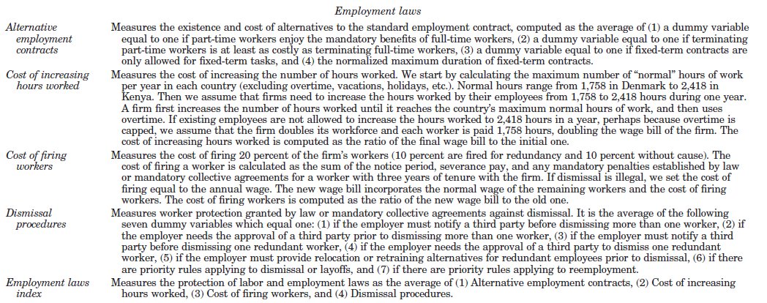
Recall this EPL index is constructed for 85 countries at one point in time, around 1997

Slide 13
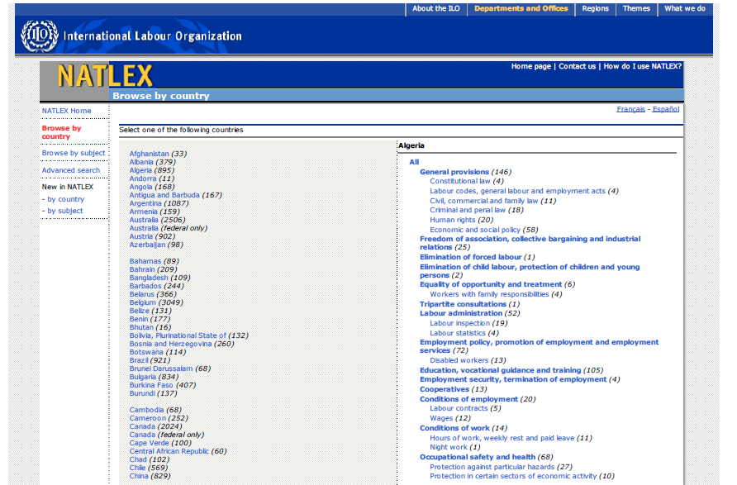
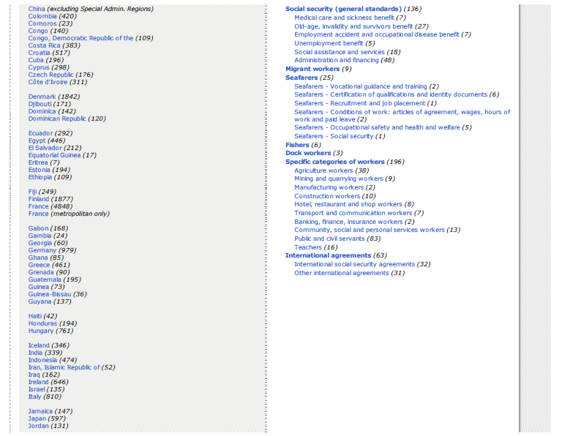
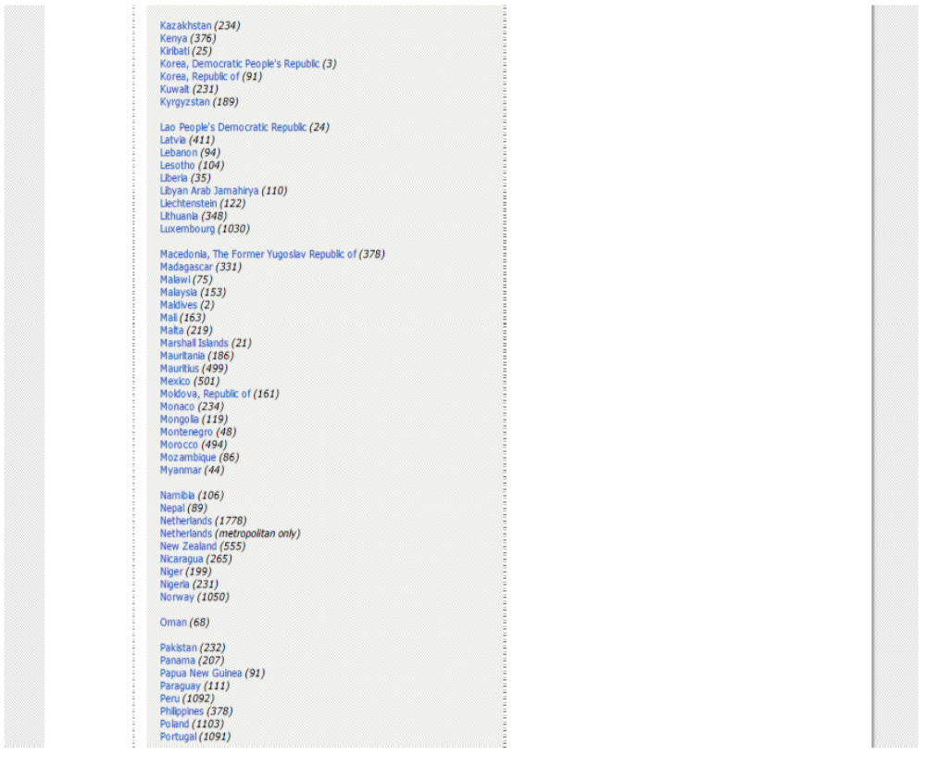
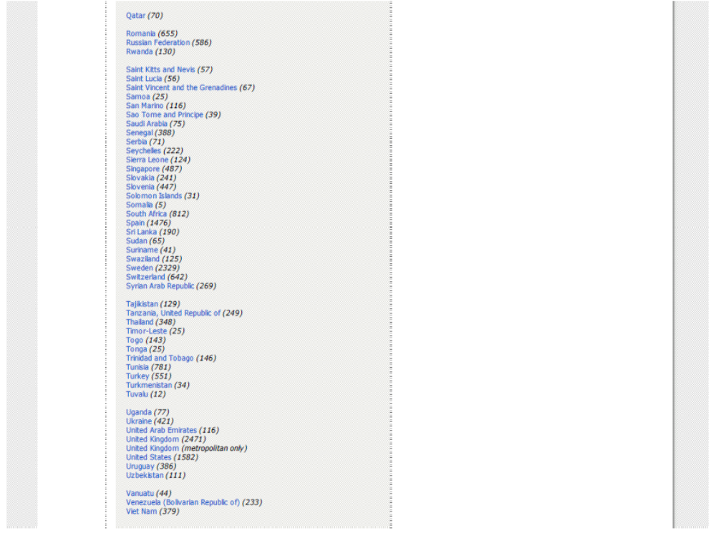
Pillar Number 2: NATLEX
iii.firing
iv. dismissal
i. contracts
ii. hours

Slide 14
Procedure (first step)
Start with Botero EPL for 1997 (web appendix with information on components)
From NATLEX: compile labour laws info (“books in 1997”; on 4 EPL components)
Check how NATLEX maps into EPL

Slide 15
Procedure (second step)
Compile relevant labour laws information (4 components) from NATLEX for 140+ countries since 1948
Code NATLEX into an extended EPL (LAMRIG)

Slide 16
Procedure (third step)
Compare this first “vintage” LAMRIG to:
Pre 1995 OECD: Blanchard and Wolfers, Allard
LAC: Heckman and Pages
Post 1995 Doing Business Surveys
Heritage Foundation
LEXADIN electronic database (on-line)

Slide 17
Procedure (final step)
National level searches for both data and analyses of the labor laws over time
Again these are made consistent with the Botero et al indexes by making use of the Sub-components
Check academic papers for single countries that have over time indexes already

Slide 18
What does LAMRIG look like?

Slide 19
Some Country Patterns
Botero et al
  Contrasted New Zealand and Portugal, which despite similar GDPPC had different Legal Origins
  But at beginning of 1970s, Portugal’s ELR was not as high
India: Started Low, gradual increase
China: Started high but has gradually declined
Jordan: High but finally fell in late 1990s
Zambia: Inverted U Pattern Over time

Slide 20
Table III.1
Country | 1960-4 | 1965-9 | 1970-4 | 1975-9 | 1980-4 | 1985-9 | 1990-4 | 1995-9 | 2000-4
China | 2 | 2 | 2 | 2 | 2 | 1.8 | 1.62 | 1.62 | 1.41
India |  | 1.1 | 1.1 | 1.15 | 1.2 | 1.3 | 1.3 | 1.3 | 1.53
Jordan | 1.7 | 1.7 | 1.7 | 1.7 | 1.7 | 1.7 | 1.7 | 1.46 | 1.52
New Zealand | 0.14 | 0.14 | 0.27 | 0.48 | 0.48 | 0.48 | 0.48 | 0.48 | 0.50
Portugal | 0.06 | 0.31 | 1.28 | 2.29 | 2.29 | 2.39 | 2.49 | 2.42 | 2.43
Zambia |  |  | 1.05 | 1.05 | 1.05 | 1.3 | 1.3 | 1.15 | 1.25
Botswana |  |  | 0.9 | 0.9 | 1.0 | 1.0 | 1.3 | 1.3 | 1.05
Ethiopia |  |  | 1.3 | 1.3 | 1.3 | 1.3 | 1.53 | 1.53 | 1.53
Philippines | 1.4 | 1.4 | 1.6 | 1.6 | 1.6 | 1.69 | 1.69 | 1.61 | 1.80

Slide 21
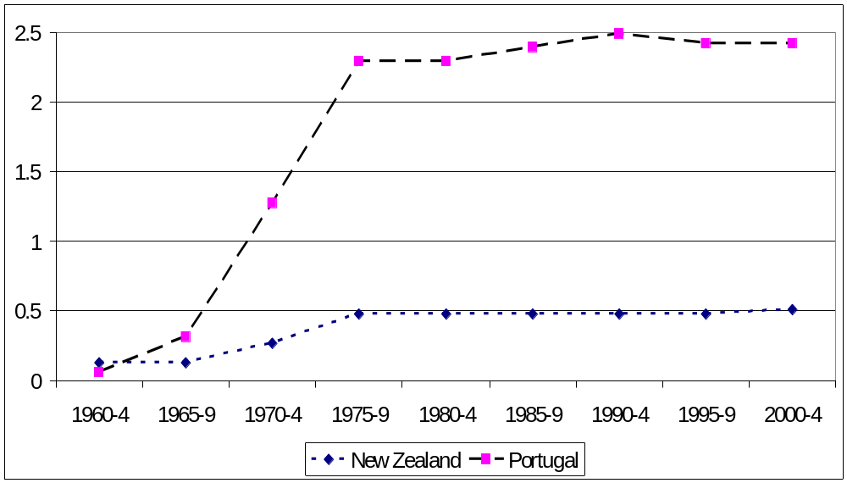
Figure 1. Rigidity of Employment Protection Legislation across Selected Countries

Slide 22
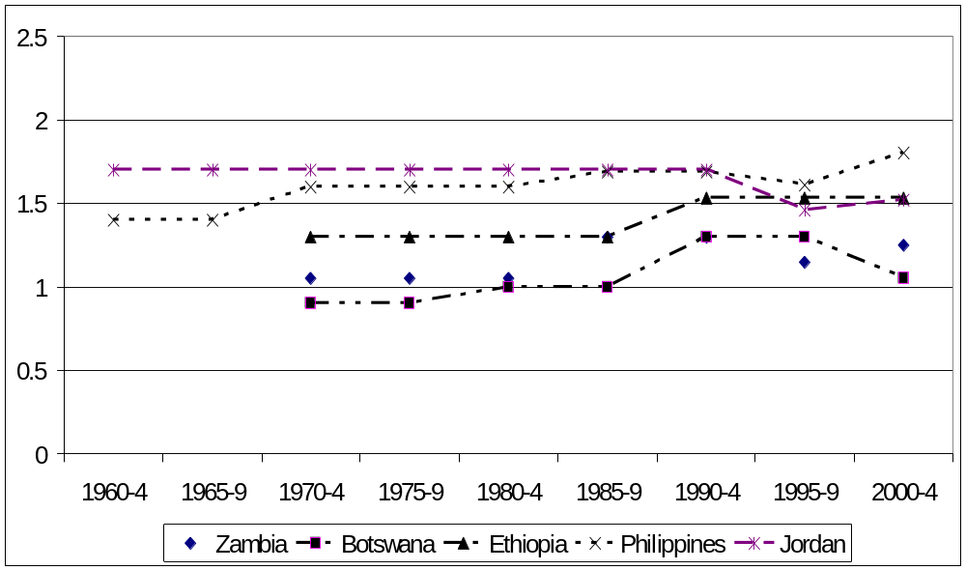
Figure 1. Rigidity of Employment Protection Legislation across Selected Countries

Slide 23
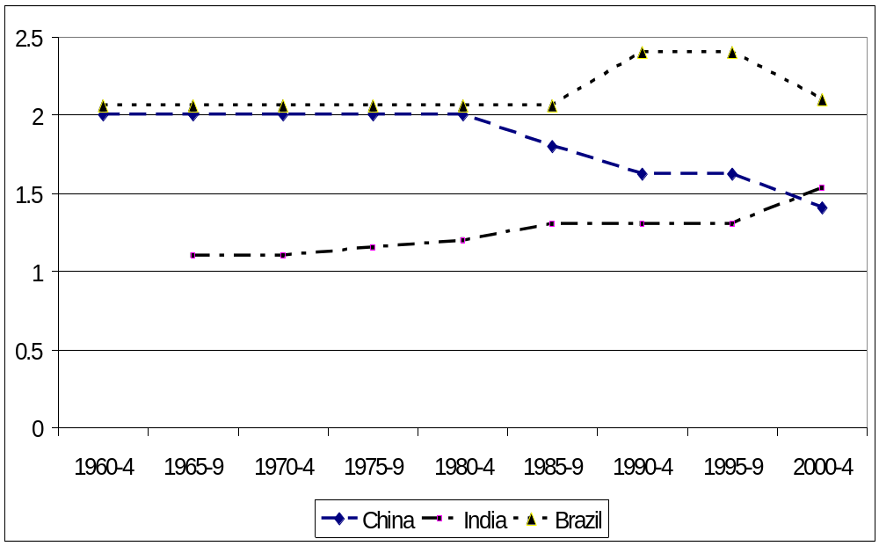
Figure 1. Rigidity of Employment Protection Legislation across Selected Countries

Slide 24
Some Factors Identified in Cases
India: Prior approval of layoffs became gradually more strict . States also. Very few requests approved despite other reforms.
China: Loosened ties of workers to housing and food rations: Alternative contracts
Jordan: Monarchy aimed at maintaining legitimacy. ELRs remained high even after privatization
Only when much stronger efforts made by govt. to promote pvt. Sector is there reform QIZ and labor intensive exports
General: Little in what we found that pointed to role of legal origins, except perhaps the transition of China to market economy ) Similar to remark of Deakin, Lele and Siems 2007 . Yet legal origins theory should be path dependent

Slide 25
Assessing Validity of LAMRIG and its Consistency with Botero et al
(with more countries and changes over time)

Slide 26
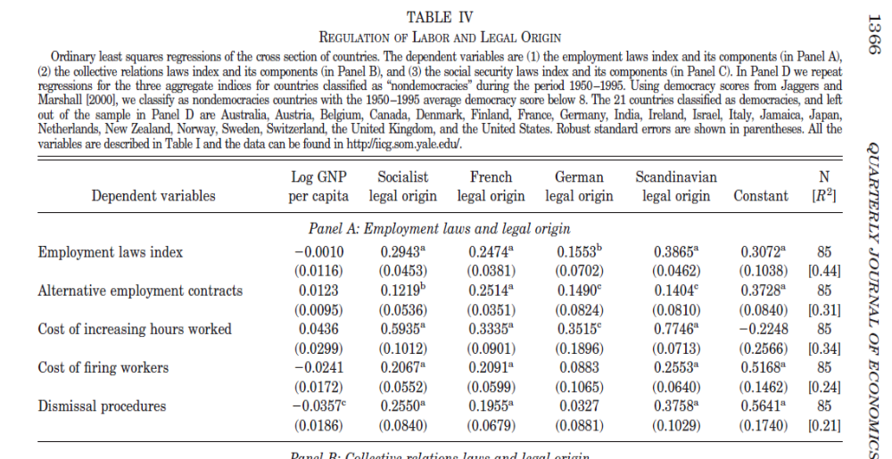
These are the first econometric results reported in Botero et al.
This is their composite index

Slide 27
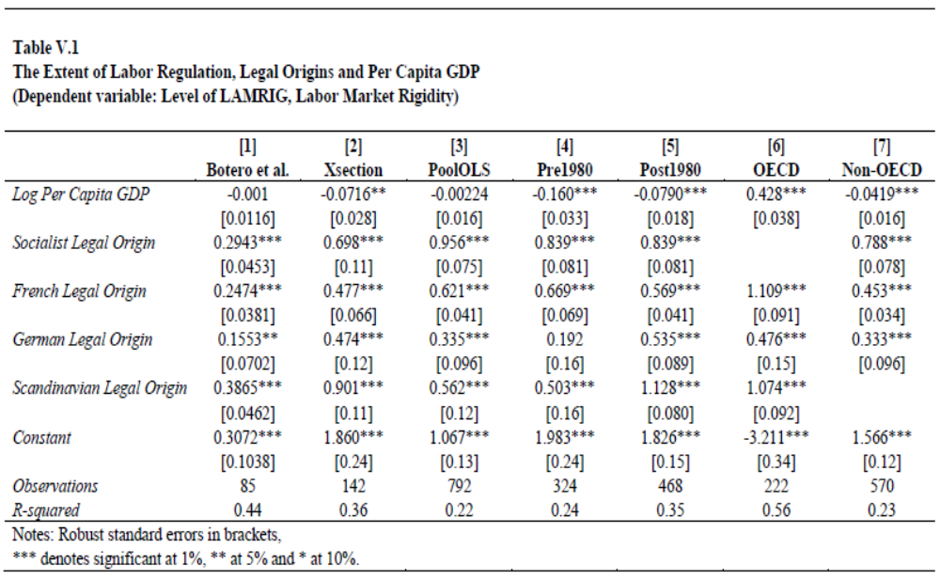
Replicating Botero et al Model with LAMRIG

Slide 28
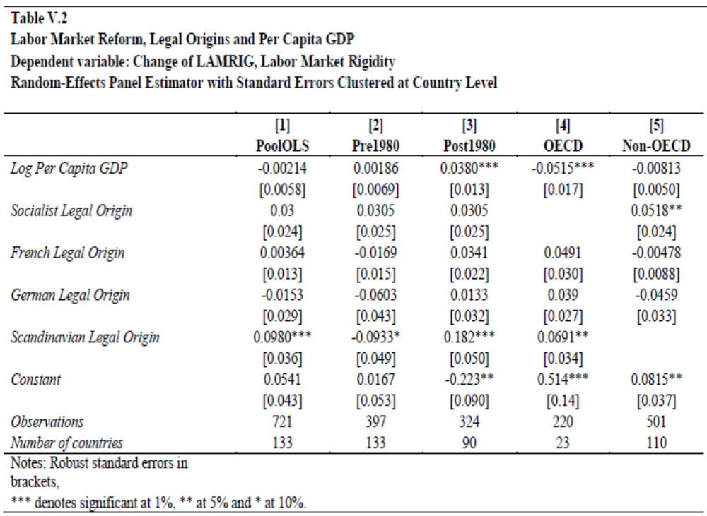

Slide 29
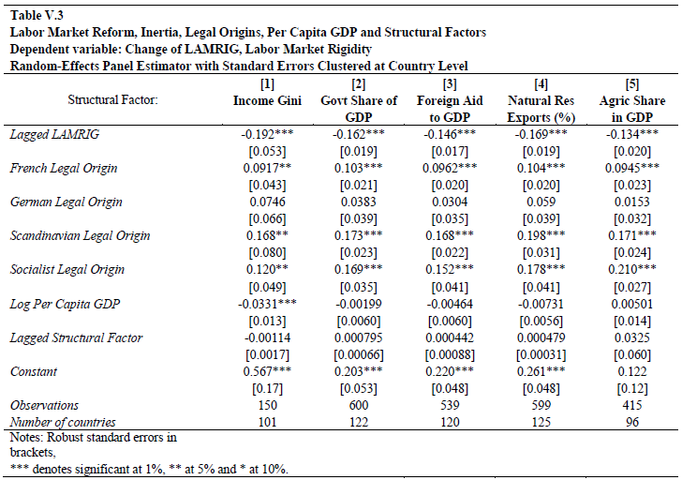
Notes:
Negative effect of GDP pc holds in some but not all specifications: richer countries reform more; Socialist, French, Scandinavian LO less LMR
Lagged Structural factors: Table V.3 Inequality (Gini) ,fuel exports (% of total X), foreign aid, gov’t size and share of agriculture have no significant effects (Govt. Share closest with + effect

Slide 30
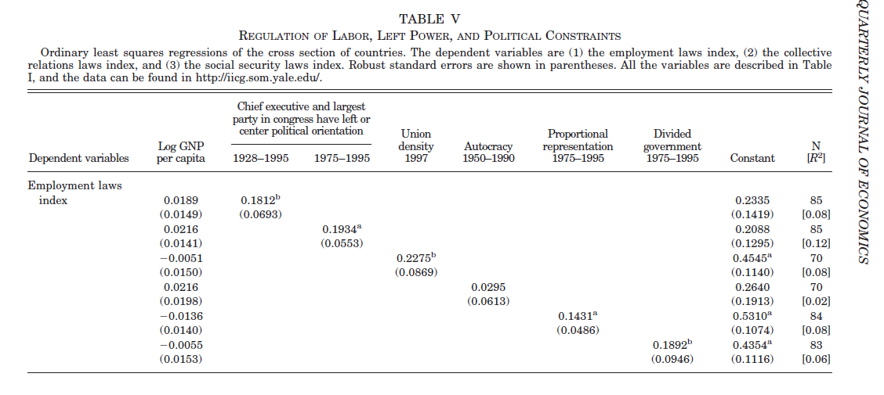
Adding Political Determinants
Lags!!!

Slide 31
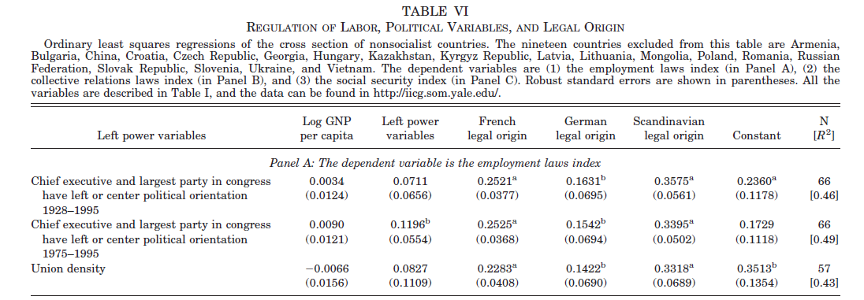

Slide 32
Extending Botero et al with other determinants
We focus on four main sets of LMR determinants besides GDPPC and Legal Origins
  Structural factors
  Political factors (crises)
  Economic crises (shocks)
  Relationship with other reforms

Slide 33
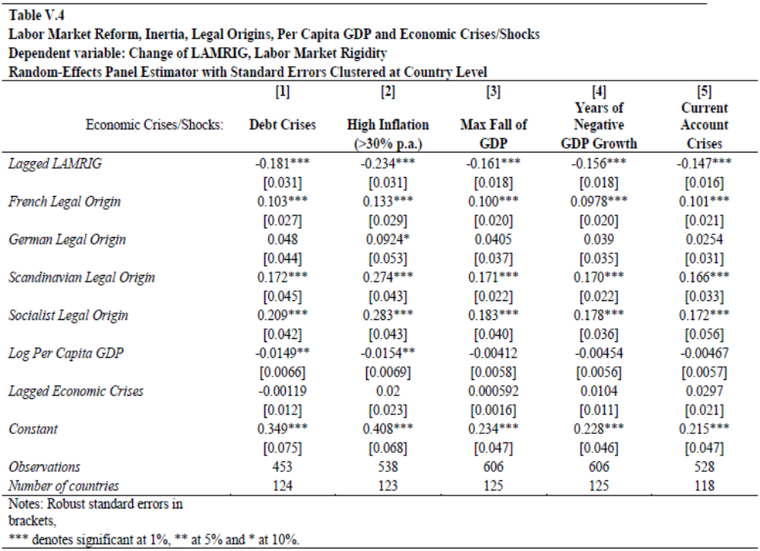
Notes:
Negative effect of GDP pc holds in some but not all specifications: richer countries reform more; Socialist, French, Scandinavian LO less LMR
Table V.4 does same for Lagged Economic Crises (Debt, Inflation, GDP Decline , CA deficit) None significant: Closest GDP fall, CA

Slide 34
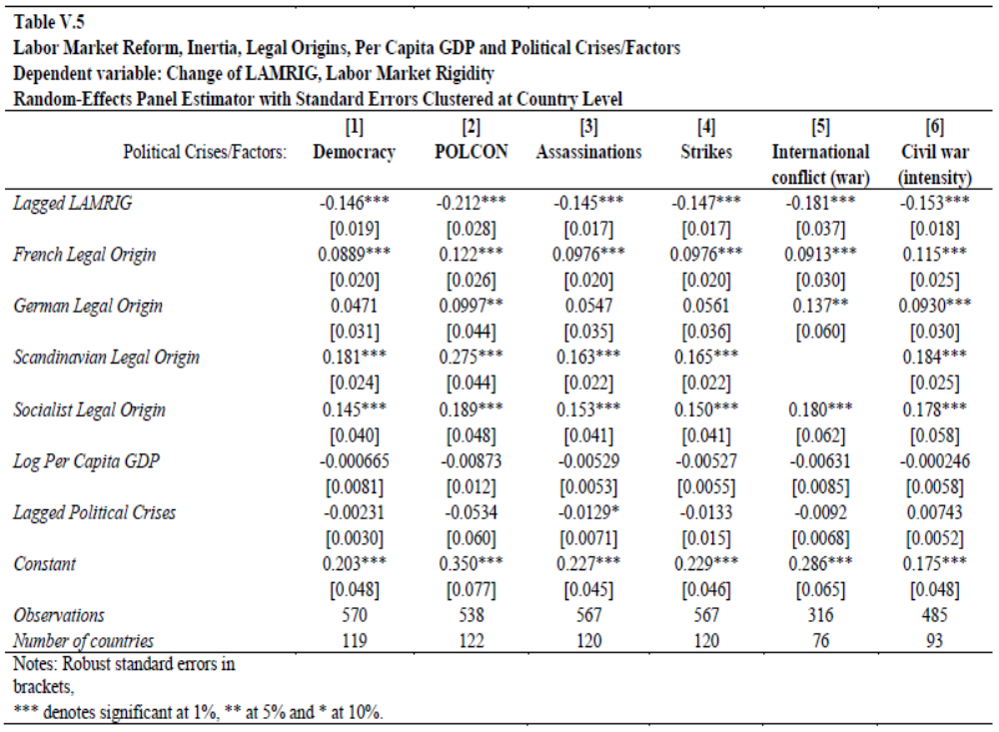
Notes:
Table V.5 Does the same for Lagged Political variables and CrisesDEMOC, POLCON, Assass, StrikesInt. War, Civil war
Only Assassinations is significant (-) helps reform
Other effects generally hold
GDP pc effect sometimes –
LAMRIG lagged - , implying convergence
French, Scandinavian and socialist LO bad for LMR but effects small
Structural, economic, Pol crises not very influential.
Next in Table V.6 : Effect of other reforms (lagged)

Slide 35
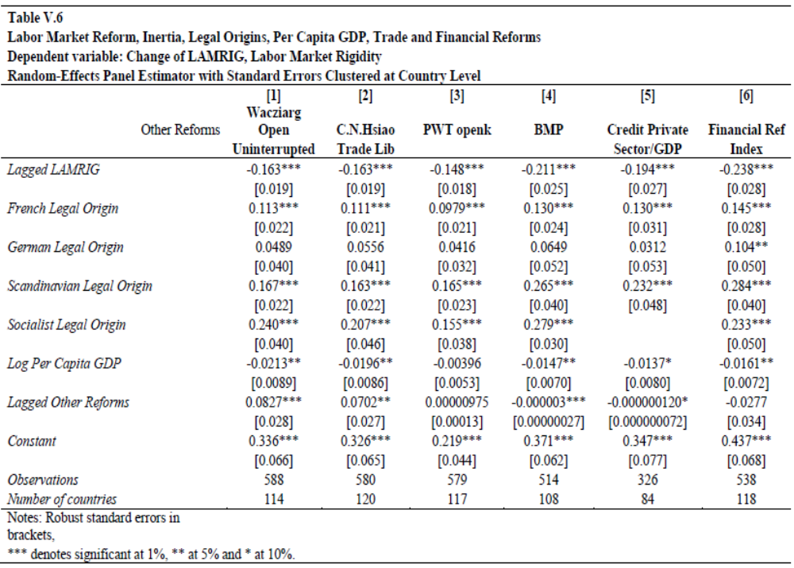
Notes:
Core results remain: Per Capita GDP Helps, Lagged LMR Makes Reform More Likely (Convergence) only partly offset by French and Socialist Legal Origins
More trade liberalization, less LMR reform (except no relation for PWT trade openness! )
Financial development may be good for reform, although coefficients insignificant
Some experiments with all factors: GDP Fall Crisis and Trade Lib findings robust

Slide 36
Conclusions
  Botero et al: efficiency, political & legal theories of EPL
  Main findings here: legal theories less strong
  Some evidence for efficiency theory (per capita GDP), little for political, but mostly
  The role of other structural reforms (-TL/+FL)

Slide 37
Extensions in Progress
Include Other Determinants
  Alesina, Cahuc et al. Cuture/religion/family ties/macho as EPL drivers
  Trade Preference Pressures AGOA, CABI, FTAs (Political scientists e.g. Cook )
  Bilateral trade partners and firm shareholders/customers to avoid sweatshop (Greenhill, Prakash. Etc.)
Use LAMRIG to assess labor market outcomes
Since Freeman, EPL may not affect growth but it reduces inequality

